Slide 1
AWS Use Case with its services
By – KMPS Tax Pvt. Ltd.
MANAS SATI (902216)
PRAPTI HAZRA (901468)

Slide 2
Serverless E-commerce Website Example with AWS Lambda

Slide 3
Case Study
A company - KMPS Tax Private Ltd wants to develop an e-commerce website. For a website, company needs a server. But maintaining a dedicated server is outdated, in fact, even a virtual server.
So the company needs a functionality so that the developers can focus on the core functionalities.
Suggest a way to solve this challenge.

Slide 4
Solution
AWS Lambda
AWS Lambda along with other AWS services can be used to build a powerful website without having to manage a single server or an operating system.
For a basic version, we will use AWS API Gateway, DynamoDB, Amazon S3, SNS and Amazon Cognito User Pool.

Slide 5
AWS Lambda
AWS Lambda is a serverless compute service that lets you run code without provisioning or managing servers, creating workload-aware cluster scaling logic, maintaining event integrations, or managing runtimes.

Slide 6
Benefits of using AWS Lambda
No servers to manage
Continuous scaling
Cost optimized with millisecond metering
Consistent performance at any scale

Slide 7
Components Used
The components used here are used for executing the following functionalities:
AWS API Gateway
DynamoDB
Amazon S3
Amazon Cognito
SNS

Slide 8
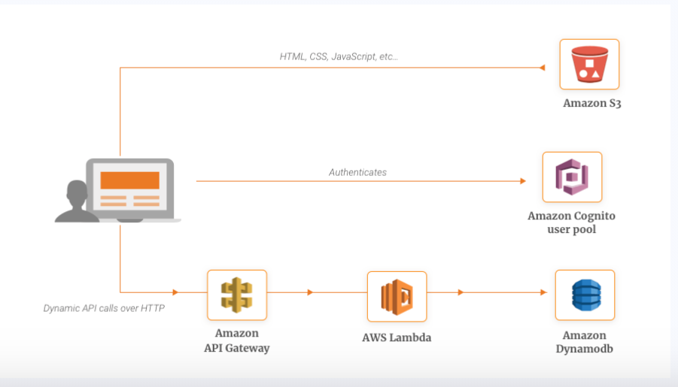

Slide 9
Features for Building an MVP for a Serverless E-commerce Application
User authentication and authorization
Product Catalog
Payment
Shopping Cart
Customer Support
Push Notifications
Shipment Tracking
Comparison Feature

Slide 10
Services used in this Case Study

Slide 11
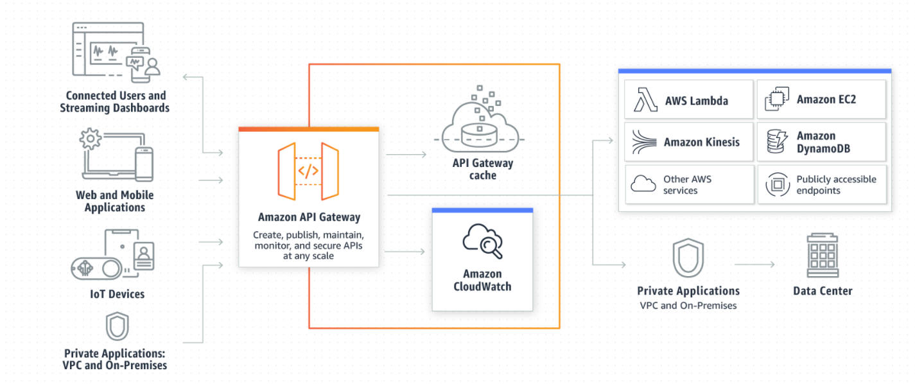
Amazon API Gateway

Slide 12
Amazon DynamoDB
Amazon DynamoDB is a key-value and document database that delivers single-digit millisecond performance at any scale.
Fully managed
Durable database with built-in security
Multi-active
Multi-region

Slide 13
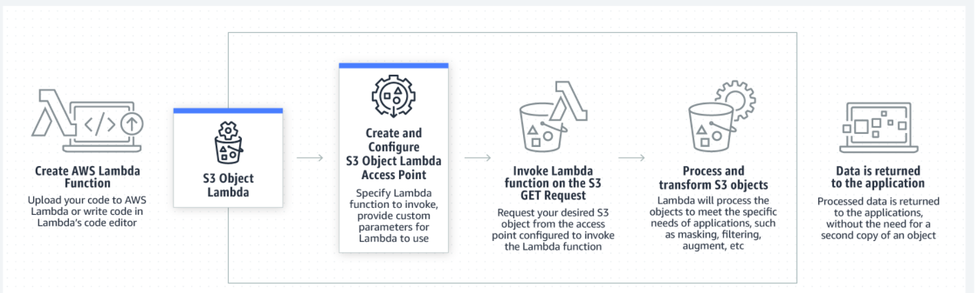
Amazon S3
Amazon Simple Storage Service (Amazon S3) is an object storage service
It offers many features like scalability, data availability, security
Designed for 99.999999999% (11 9's) of durability
99.99% availability

Slide 14
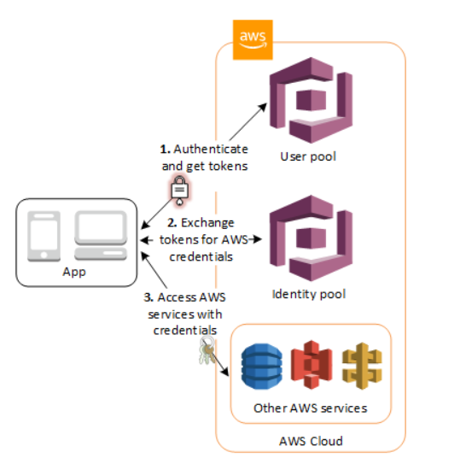
Amazon Cognito
Amazon Cognito provides authentication, authorization, and user management for your web and mobile apps.
There are two main components of Amazon Cognito : -
User pools
Identity pools

Slide 15
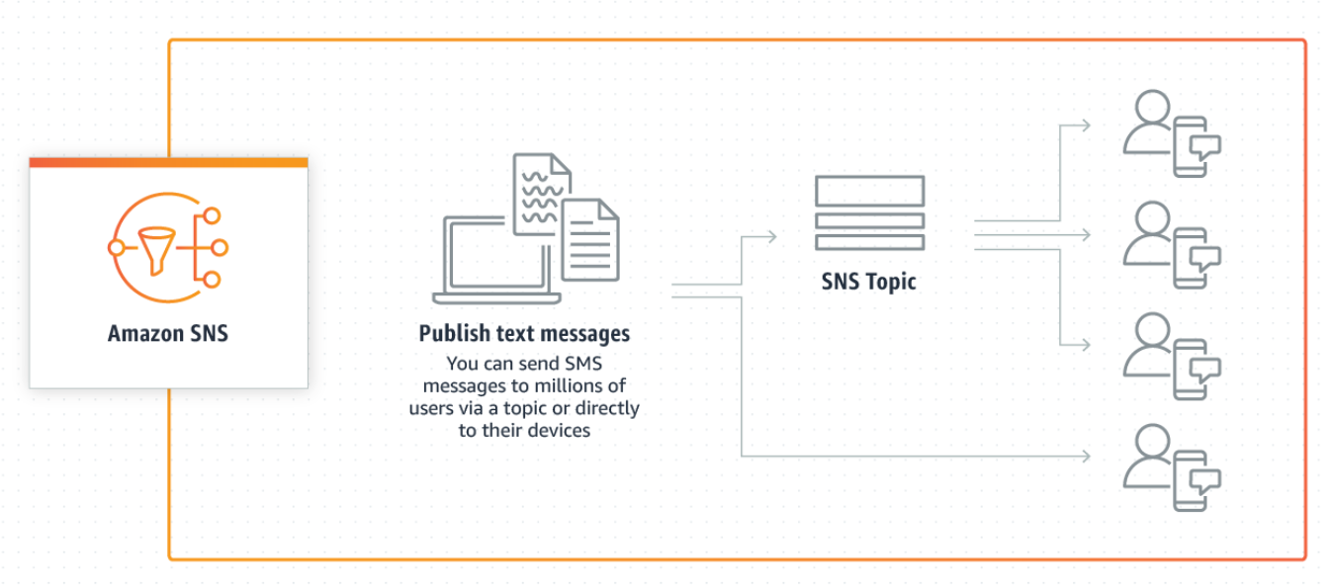
Amazon Simple Notification Service
Amazon SNS is a fully managed messaging service for both application-to-application (A2A) and application-to-person (A2P) communication

Slide 16
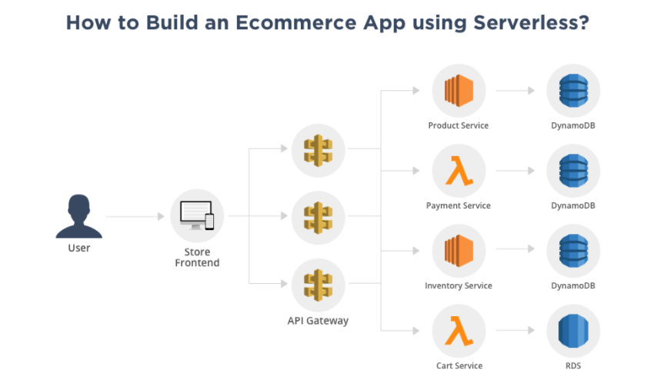

Slide 17
Architecture of our Case Study

Slide 18
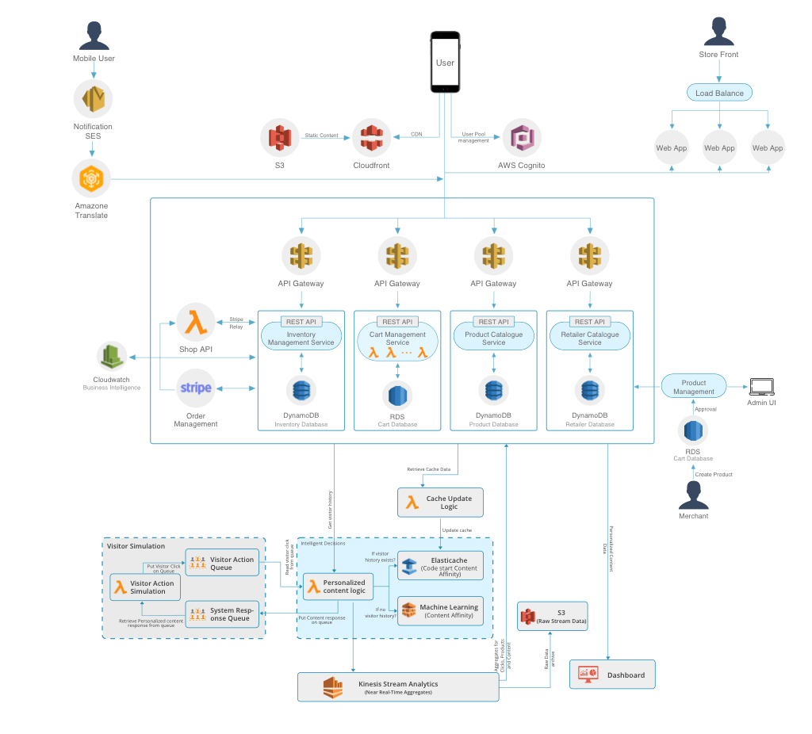

Slide 19
Thank You!!!

